Slide 1

Robot Learning Control: Gaussian Process Robotics II 2019-2020
Fioretti Gianmarco Mauro Alessandro Nicotra Emanuele
Special Thanks to Marco Capotondi

Slide 2
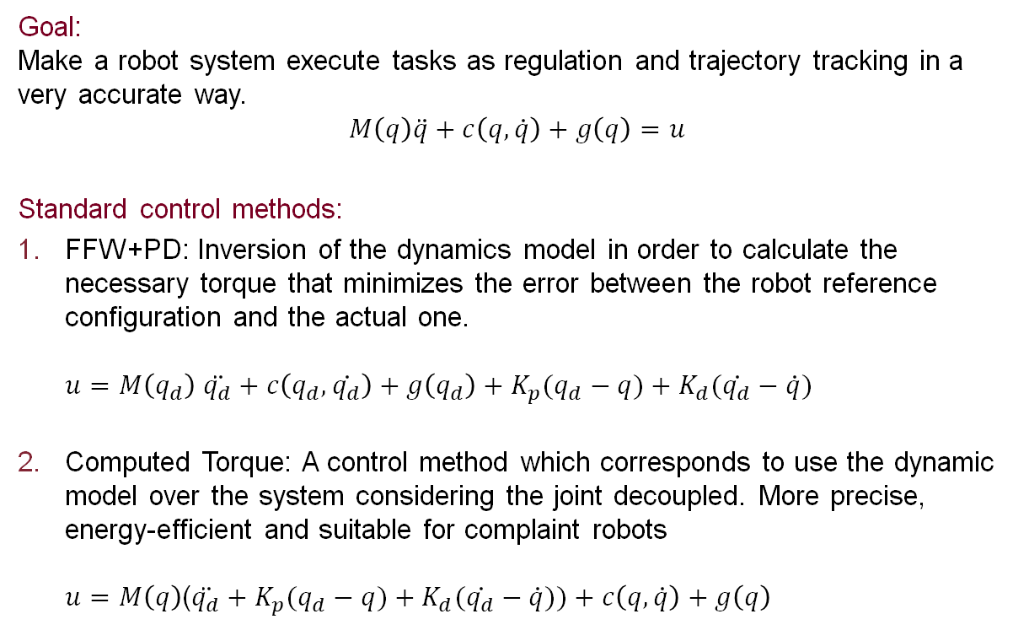
Introduction
Robot Learning Algorithm
Goal: Make a robot system execute tasks as regulation and trajectory tracking in a very accurate way.
$$M\left(q\right)\ddot{q}+c\left(q,\dot{q}\right)+g\left(q\right)=u$$
Standard control methods:
FFW+PD: Inversion of the dynamics model in order to calculate the necessary torque that minimizes the error between the robot reference configuration and the actual one. $u=M\left(q_{d}\right)$ $\ddot{q_{d}}+c\left(q_{d},\dot{q_{d}}\right)+g\left(q_{d}\right)+K_{p}(q_{d}−q)+K_{d}(\dot{q_{d}}−\dot{q})$
Computed Torque: A control method which corresponds to use the dynamic model over the system considering the joint decoupled. More precise, energy-efficient and suitable for complaint robots $u=M\left(q\right)$($\ddot{q_{d}}+K_{p}(q_{d}−q)+K_{d}(\dot{q_{d}}−\dot{q}))+c\left(q,\dot{q}\right)+g\left(q\right)$

Slide 3
Introduction
Robot Learning Algorithm
Problems:
Exact knowledge of the dynamic robot model is required.
Mismatches between the nominal dynamic model and the actual behaviour of the robot appear.
Lack of optimality and robustness
Solutions:
Robot learning algorithms are the suitable tools to better approximate the dynamic model and being able apply a correction to the Feedback Linearization and so correctly linearize the system.
Choice of the algorithm:
Gaussian Process Regression is the method we are going to explain and implement in the following. It will be implemented over the corresponding torque errors, between the nominal dynamic model and the ”real one”.

Slide 4
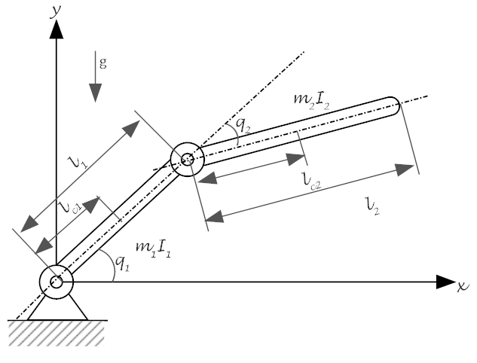
Robot Models
Nominal Robot Model
2R Planar Robot
 | Link 1 | Link 2
a | 2 | 1
θ | q1 | q2
d | 0 | 0
α | 0 | 0
m | 1 | 1

Slide 5
Robot Models
Real Robot Model
2R Planar Robot
 | Link 1 | Link 2
a | 2.1 | 0.8
θ | q1 | q2
d | 0 | 0
α | 0 | 0
m | 1 | 1.16

Slide 6
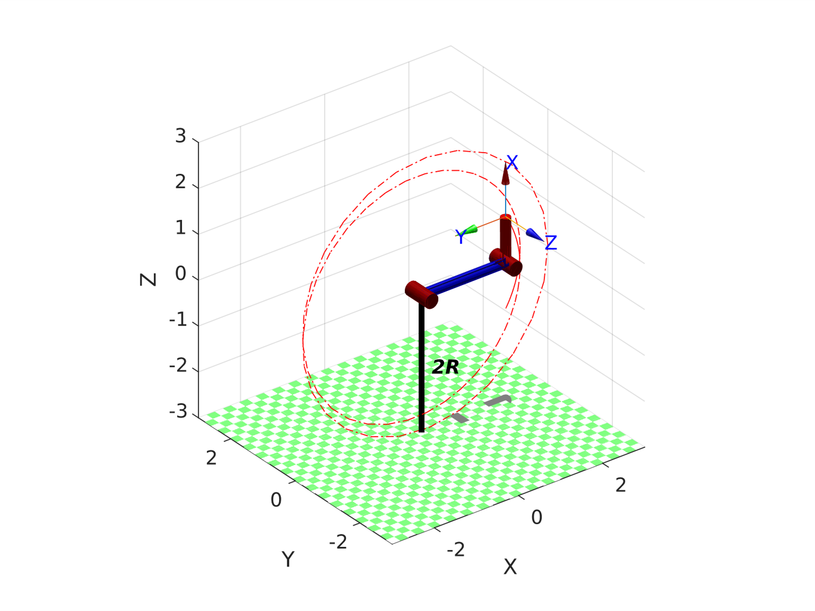
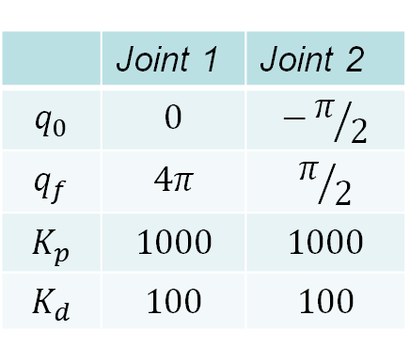
Computed Torque
Simulation
 | Joint 1 | Joint 2
$$q_{0}$$ | $$0$$ | $$−π/2$$
$$q_{f}$$ | $$4π$$ | $$π/2$$
$$K_{p}$$ | $$1000$$ | $$1000$$
$$K_{d}$$ | $$100$$ | $$100$$

Slide 7
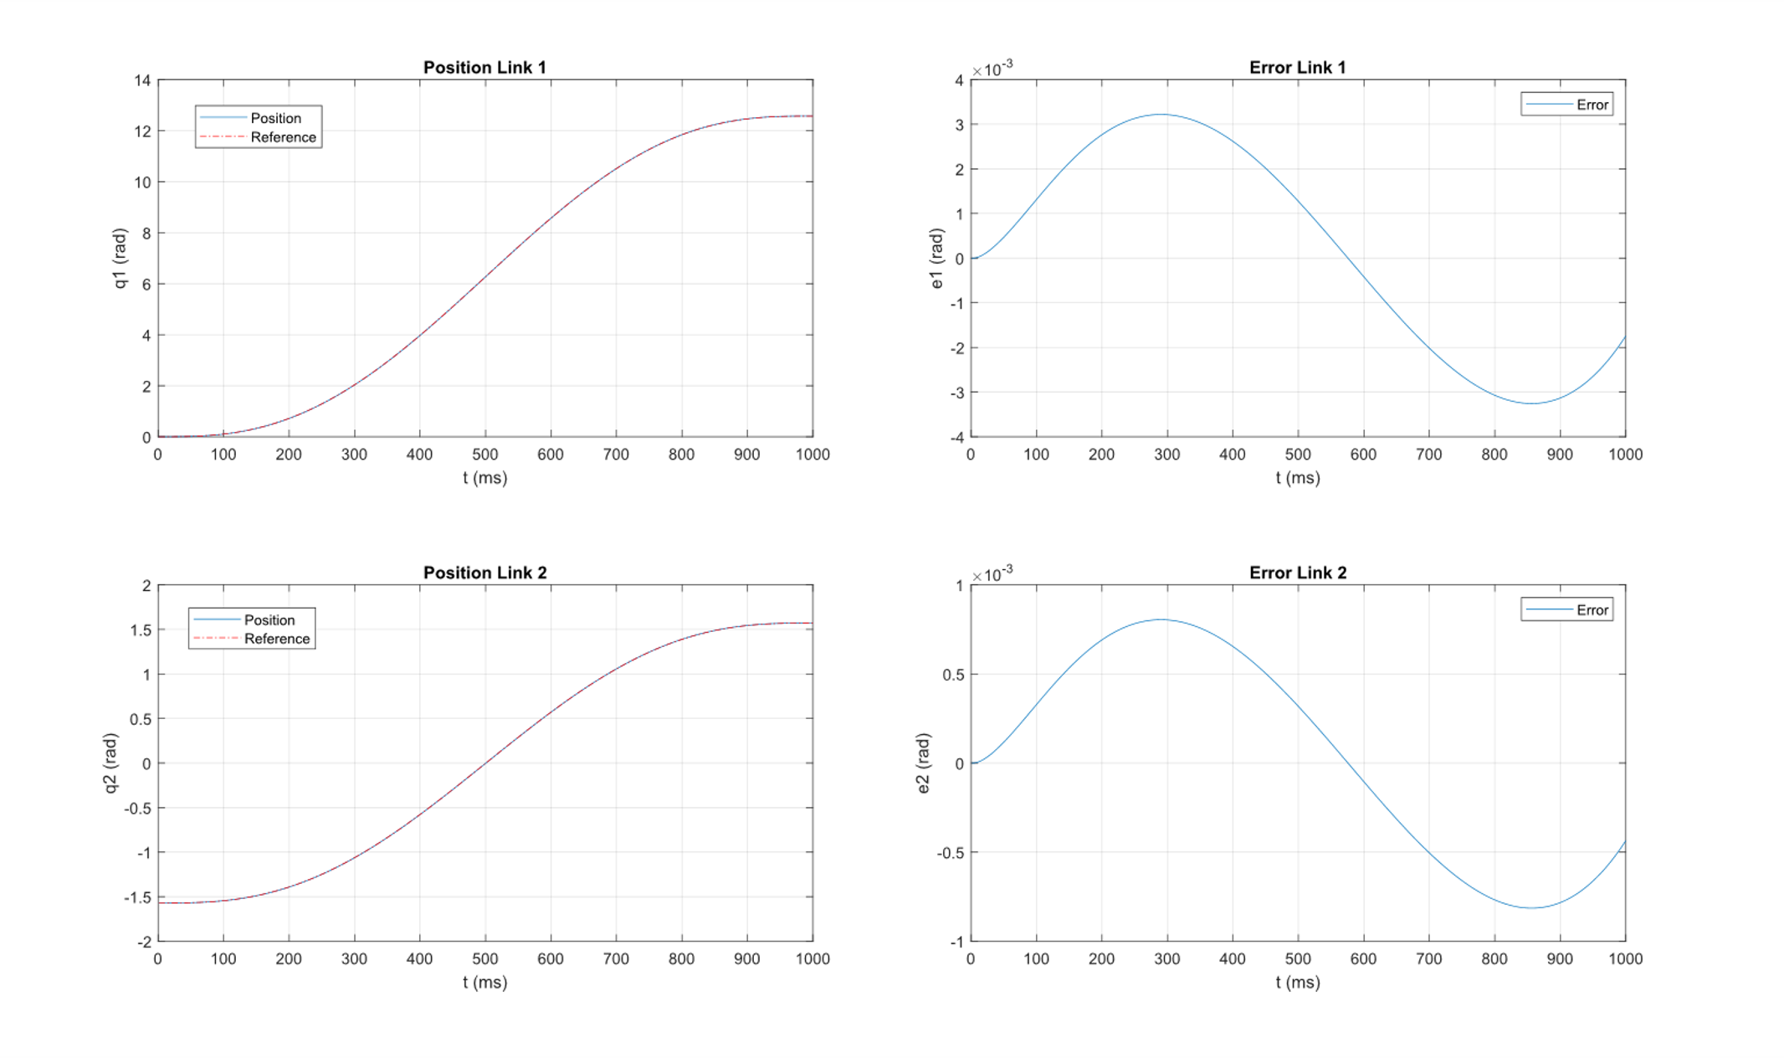
Computed Torque
Simulation

Slide 8
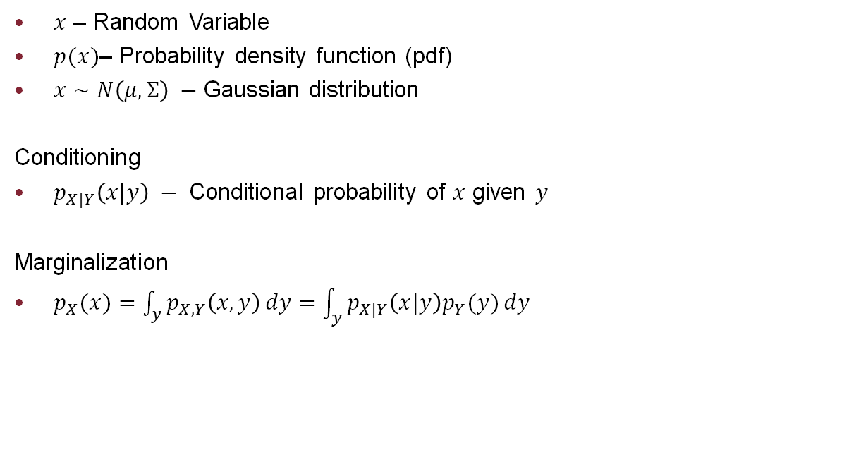
Gaussian Process
Basics in Probability
$x$ – Random Variable
$p(x)$– Probability density function (pdf)
$x∼N\left(μ,Σ\right) −$ Gaussian distribution
Conditioning
$p_{X|Y}\left(x|y\right) −$ Conditional probability of $x$ given $y$
Marginalization
$p_{X}(x)=\int_{y}{p_{X,Y}\left(x,y\right)}dy$ $=\int_{y}{p_{X|Y}\left(x|y\right)p_{Y}(y)}dy$

Slide 9
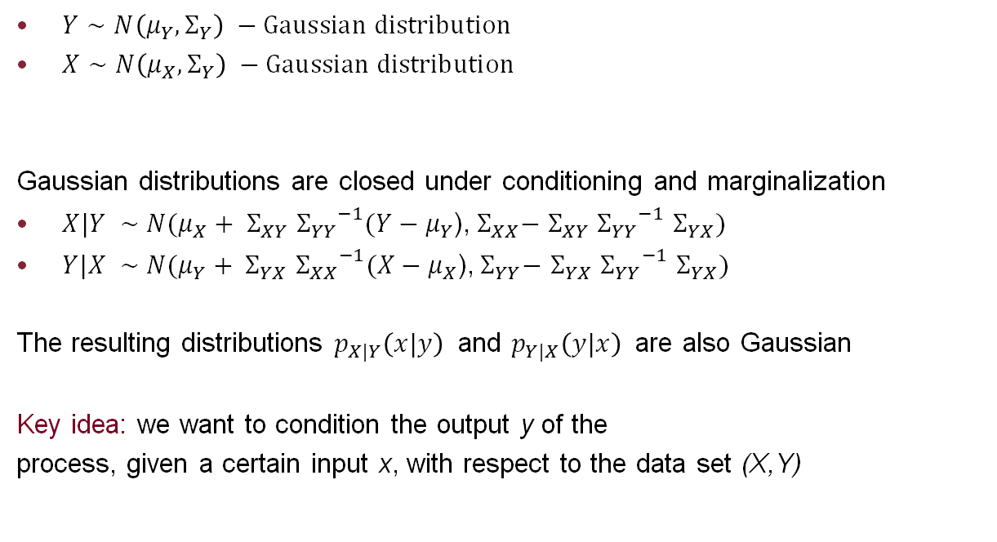
Gaussian Process
Properties of Gaussian Probability Density Funciton
$Y∼N\left(μ_{Y},Σ_{Y}\right) −Gaussian distribution$
$X∼N\left(μ_{X},Σ_{Y}\right) −Gaussian distribution$
Gaussian distributions are closed under conditioning and marginalization
$X|Y ∼$ $N(μ_{X}+ Σ_{XY}$ ${Σ_{YY}}^{−1}(Y−μ_{Y}$),${ Σ}_{XX}−$ $Σ_{XY}$ ${Σ_{YY}}^{−1}$ $Σ_{YX})$
$Y|X ∼$ $N(μ_{Y}+ Σ_{YX}$ ${Σ_{XX}}^{−1}(X−μ_{X}$),${ Σ}_{YY}−$ $Σ_{YX}$ ${Σ_{YY}}^{−1}$ $Σ_{YX})$
The resulting distributions $p_{X|Y}\left(x|y\right)$ and $p_{Y|X}\left(y|x\right)$ are also Gaussian
Key idea: we want to condition the output y of the
process, given a certain input x, with respect to the data set (X,Y)

Slide 10
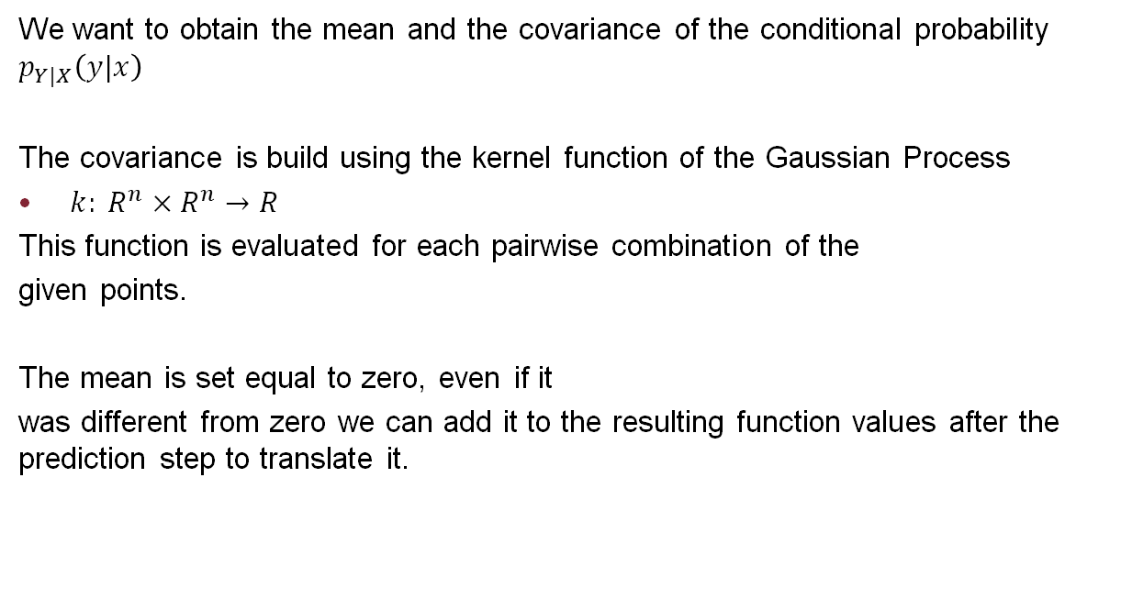
Gaussian Process
Mean and Covariance computation
We want to obtain the mean and the covariance of the conditional probability $p_{Y|X}\left(y|x\right)$
The covariance is build using the kernel function of the Gaussian Process
$k: R^{n}×R^{n}$ $→R$
This function is evaluated for each pairwise combination of the
given points.
The mean is set equal to zero, even if it
was different from zero we can add it to the resulting function values after the prediction step to translate it.

Slide 11

Gaussian Process
Notation
$X$– Training points set
$x −$ Input
$y −$ Output
$\left(x,y\right)∈X$
$X^{∗}$ $−$ Test points set
$x^{∗}−$Test point
$x^{∗}∈X^{∗}$
${f(x}^{∗})−$Function value at the point $x^{∗}$
$ε∼N\left(0,{σ_{n}}^{2}\right) −$ White Gaussian noise
$K(A,B) −$ covariance matrix between A and B built using the kernel function

Slide 12

Gaussian Process
Probability density computation (Noise-free)
The joint distribution between the training and the test set is a Gaussian distribution
$P_{X^{∗},X}$ $=\left[\begin{matrix}y \\ {f(x}^{∗})\end{matrix}\right]$ $∼N\left(\begin{matrix}0 , & \left[\begin{matrix}K(X,X) & K(X,X^{∗}) \\ K(X^{∗},X) & k(X^{∗},X^{∗})\end{matrix}\right]\end{matrix}\right)$
From which we can obtain the conditional distribution using the conditioning operation, in particular its mean and covariance are respectively
${f(x}^{∗})=k^{∗T}\left(K^{−1}\right)y$
${V(x}^{∗})=k\left(x^{∗},x^{∗}\right)−k^{∗T}\left(K^{−1}\right)k^{∗}$
Where
$K=K\left(X,X\right)$∈ $R^{n}×R^{n}$
$k^{∗T}=K(X^{∗},X)$ $∈$ $R×R^{n}$

Slide 13

Gaussian Process
Probability density computation (with noise)
The joint distribution between the training and the test set is a Gaussian distribution
$P_{X^{∗},X}$ $=\left[\begin{matrix}y \\ {f(x}^{∗})\end{matrix}\right]$ $∼N\left(\begin{matrix}0 , & \left[\begin{matrix}K\left(X,X\right)+{σ_{n}}^{2}I & K(X,X^{∗}) \\ K(X^{∗},X) & k(X^{∗},X^{∗})\end{matrix}\right]\end{matrix}\right)$
From which we can obtain the conditional distribution using the conditioning operation, in particular its mean and covariance are respectively
${f(x}^{∗})=k^{∗T}\left(K^{−1}+{σ_{n}}^{2}I\right)y$
${V(x}^{∗})=k\left(x^{∗},x^{∗}\right)−k^{∗T}\left(K^{−1}+{σ_{n}}^{2}I\right)k^{∗}$
Where
$K=K\left(X,X\right)$∈ $R^{n}×R^{n}$
$k^{∗T}=K(X^{∗},X)$ $∈$ $R×R^{n}$

Slide 14
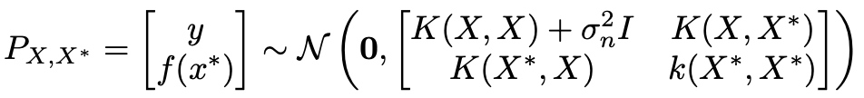
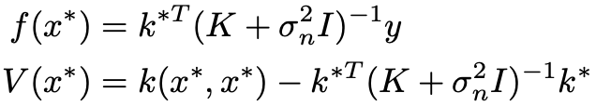
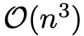
GP Sparsification
Why do we need sparsification?

Slide 15
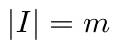
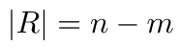
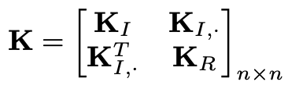
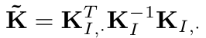
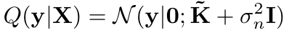
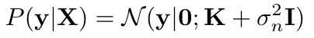


GP Sparsification
Nystrøm Approximation
Such that
Instead of

Slide 16
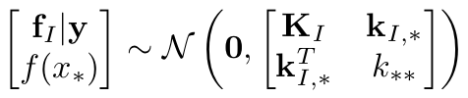
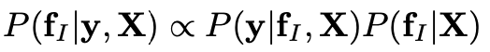
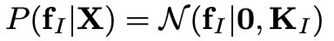
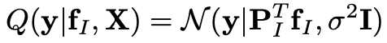
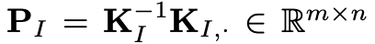
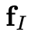
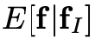


GP Sparsification
Projected Process Approximation
with
(
)

Slide 17
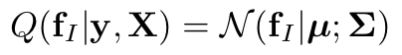
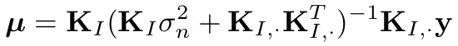
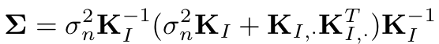
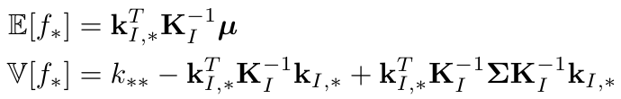
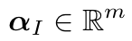
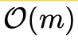


GP Sparsification
Projected Process Approximation
With

Slide 18
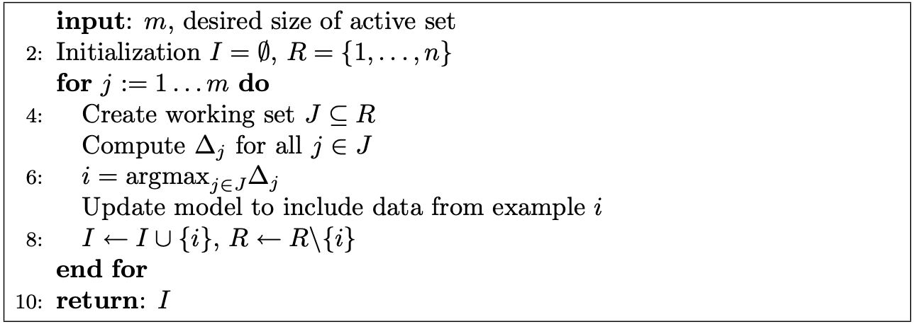

GP Sparsification
Heuristic
General for greedy subset selection. $∆_{j}$ is the criterion function evaluated on data point j.
Reference: C. E. Rasmussen & C. K. I. Williams, ”Gaussian Processes for Machine Learning”, the MIT Press, 2006.

Slide 19

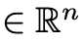
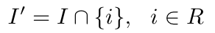
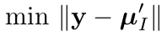
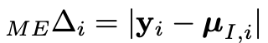
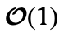
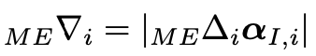



GP Sparsification
Heuristic
With
Reference: J. Schreiter, D. Nguyen-Tuong, M. Toussaint, “Efficient sparsification for Gaussian process regression”, 2016.

Slide 20

Gaussian Process Regression
Implementation
Data Generation
$M(q)$ $\ddot{q}$ $+c\left(q,\dot{q}\right)+g\left(q\right)=u$
GP Training
$x_{i}=[q_{i},{\dot{q}}_{i},{\ddot{q}}_{i}]$
$y_{i}=[Δu_{i}]$
$k\left(x,x^{′}\right)=σe^{−\frac{1}{2}{\left(x−x^{′}\right)}^{T}W(x−x^{′})}$ Radial Basis Function Kernel (RBF)
$W=$Diagonal weight matrix

Slide 21
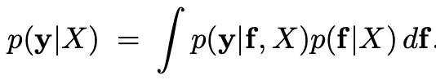
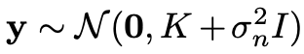


Gaussian Process Regression
Implementation
Hyperparameters Optimization
Max LML (Logarithmic Marginal Likelihood)
$\log{p\left(y | X,θ\right)=\frac{1}{2}}y^{T}$ ${(K+{σ_{n}}^{2}I)}^{−1}y+$ $\frac{1}{2}$ $\log\left|K+{σ_{n}}^{2}I\right|+$ $\frac{n}{2}$ $\log{(2π )}$
Given that

Slide 22
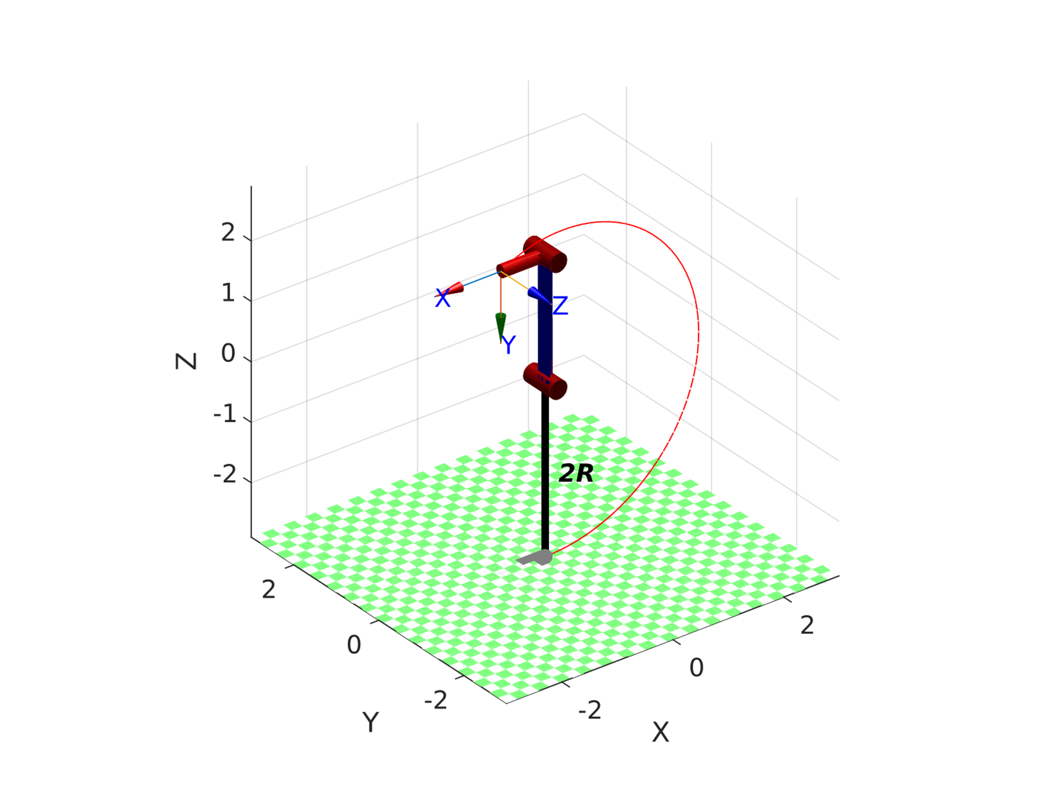
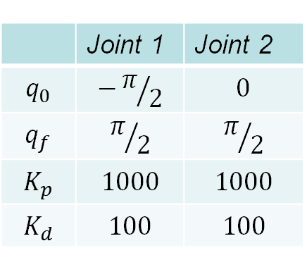
Offline Gaussian Process
Simulation – Known Trajectory
 | Joint 1 | Joint 2
$$q_{0}$$ | $$−π/2$$ | $$0$$
$$q_{f}$$ | $$π/2$$ | $$π/2$$
$$K_{p}$$ | $$1000$$ | $$1000$$
$$K_{d}$$ | $$100$$ | $$100$$

Slide 23
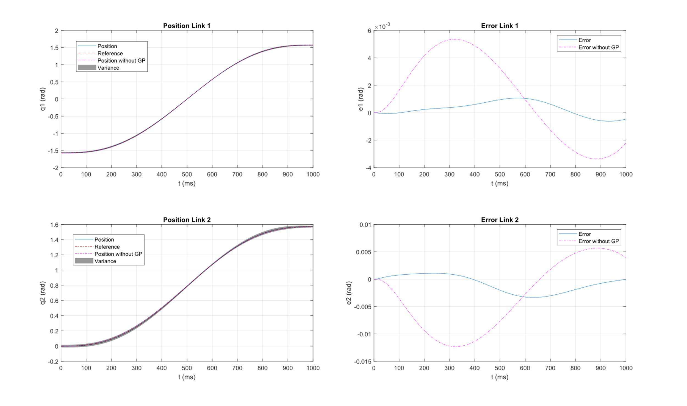
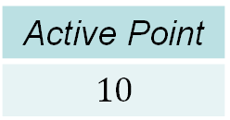
Offline Gaussian Process
Active Point
$$10$$
Simulation – Known Trajectory

Slide 24
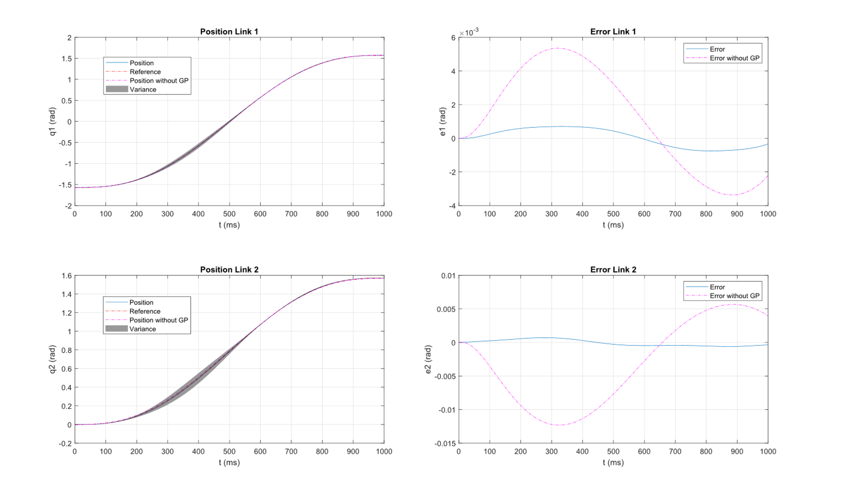
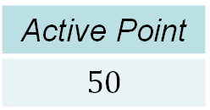
Offline Gaussian Process
Active Point
$$50$$
Simulation – Known Trajectory

Slide 25
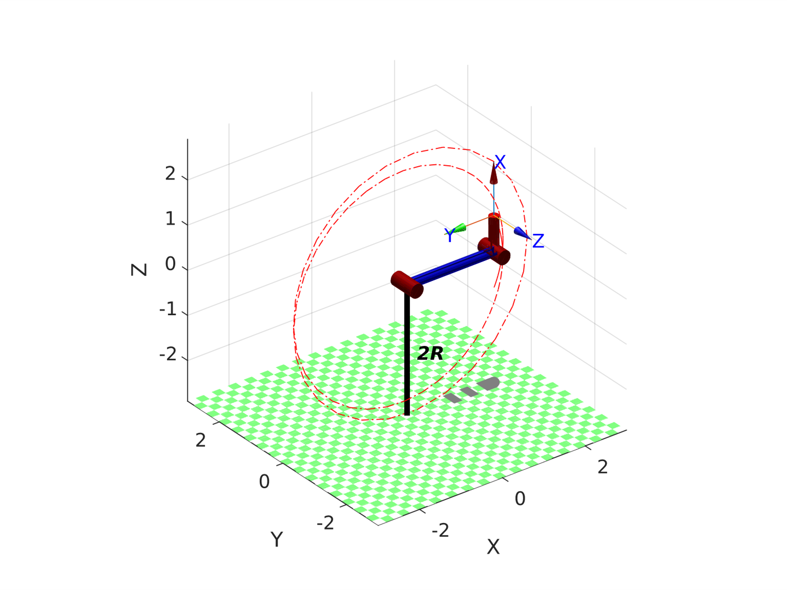
Offline Gaussian Process
Simulation – Unknown Trajectory
 | Joint 1 | Joint 2
$$q_{0}$$ | $$0$$ | $$−π/2$$
$$q_{f}$$ | $$4π$$ | $$π/2$$
$$K_{p}$$ | $$1000$$ | $$1000$$
$$K_{d}$$ | $$100$$ | $$100$$

Slide 26

Offline Gaussian Process
Active Point
$$10$$
Simulation – Unknown Trajectory

Slide 27

Offline Gaussian Process
Active Point
$$50$$
Simulation – Unknown Trajectory

Slide 28

Offline Gaussian Process
Active Point
$$50$$
Simulation – Without Heuristic

Slide 29

Online Gaussian Process
Simulation
 | Joint 1 | Joint 2
$$q_{0}$$ | $$0$$ | $$−π/2$$
$$q_{f}$$ | $$4π$$ | $$π/2$$
$$K_{p}$$ | $$1000$$ | $$1000$$
$$K_{d}$$ | $$100$$ | $$100$$

Slide 30

Online Gaussian Process
Active Point
$$10$$
Simulation

Slide 31

Online Gaussian Process
Active Point
$$50$$
Simulation

Slide 32
Conclusions
A very powerful Tool
So far, we have achieved the anticipated results
Model mismatches compensation
Lower gains needed
However, there are still some drawbacks as the Generalization error problem.
Thanks for the attention!

